Slide 1

Module 08
Managing Files and Directories

Slide 2
Introduction

Slide 3

Introduction
In this chapter we will discuss how to manipulate files and directories.
Some Linux distributions have GUI-based applications that allow you to manage files, but it is advantageous to know how to perform these operations via the command line.
Note that everything in Linux is case sensitive so pay attention to capitalization:
  The hello.txt file is different from the HELLO.txt and Hello.txt files.

Slide 4
Globbing

Slide 5
Globbing
Glob characters are often referred to as wild cards.
These are symbol characters that have special meaning to the shell.
Globs are powerful because they allow you to specify patterns that match filenames in a directory:
  Instead of manipulating a single file at a time, you can easily execute commands that will affect many files.

Slide 6


Globbing - The Asterisk *
The asterisk character is used to represent zero or more of any character in a filename.
For example, suppose you want to display all of the files in the /etc directory that begin with the letter t:
The pattern t* matches any file in the /etc directory that begins with the character t followed by zero or more of any character.

Slide 7


Globbing - The Question Mark ?
The question mark character matches exactly one character, no more and no less.
Suppose you want to display all of the files in the /etc directory that begin with the letter t and have exactly 7 characters after the t character:
The asterisk and question mark could also be used together to look for files with three-letter extensions by running the echo /etc/*.??? command:

Slide 8


Globbing - Brackets [ ]
Brackets are used to match a single character by representing a range of characters that are possible match characters.
For example, echo /etc/[gu]* will print any file that begins with either a g or u character and contains zero or more additional characters:
Brackets can also be used to a represent a range of characters by using the - character (i.e., any letter between and including a and d):

Slide 9
Globbing - Exclamation Point !
The exclamation point is used in conjunction with the square brackets to negate a range.
For example, the command echo /etc/[!a-t]* will display any file that does not begin with an a thru t:

Slide 10
Globbing - Listing With Globs
When the ls command sees a directory as an argument, it will display the contents of the directory, not just the directory name.
Use the -d option, which tells the ls command to display the name of directories, instead of their contents:
sysadmin@localhost:~$ ls -d /etc/e*
/etc/encript.cfg /etc/environment /etc/ethers /etc/event.d /etc/exports

Slide 11
8.3 Copying Files and Directories

Slide 12
Copying Files
The cp command is used to copy files. It requires a source and a destination.
The structure of the command is as follows:
The source is the file to be copied. The destination is where the copy is to be located.
The following command will copy the /etc/hosts file to your home directory:
cp [source] [destination]
sysadmin@localhost:~$ cp /etc/hosts ~
sysadmin@localhost:~$ ls
Desktop Downloads Pictures Templates hosts
Documents Music Public Videos

Slide 13
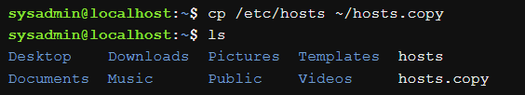
8.3.1 Copying Files - Verbose Mode
The -v option will cause the cp command to produce output if successful.
The -v option stands for verbose.
An example of the -v option used with the cp command:
When the destination is a directory, the resulting new file will have the same name as the original file.
If you want the new file to have a different name, you must provide the new name as part of the destination.
sysadmin@localhost:~$ cp -v /etc/hosts ~
`/etc/hosts' -> `/home/sysadmin/hosts'

Slide 14
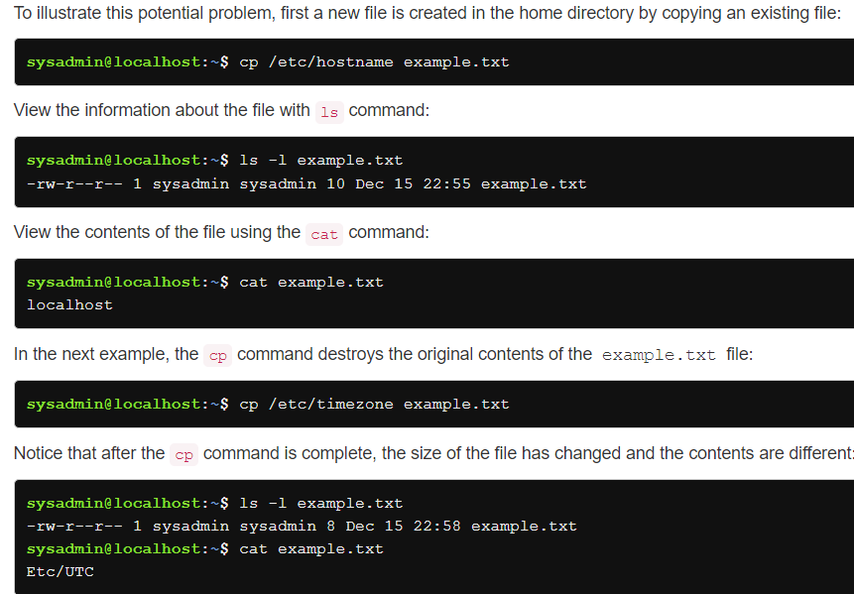
8.3.2 Copying Files - Avoid Overwriting Data
The cp command can be destructive to existing data if the destination file already exists. In the case where the destination file exists, the cp command overwrites the existing file's contents with the contents of the source file.

Slide 15
8.3.2 Copying Files - Avoid Overwriting Data (2)
The cp command can be destructive to existing data if the destination file already exists.
With the -i (interactive) option, the cp will prompt before overwriting a file (y (yes) or n (no)):
The -i option requires you to answer y or n for every copy which could be tedious if there are a lot of files.
If you want to automatically answer n to each prompt, use the -n option. It essentially stands for "no overwrite”.
sysadmin@localhost:~$ cp -i /etc/hosts ~/example.txt
cp: overwrite `/home/sysadmin/example.txt'? n

Slide 16
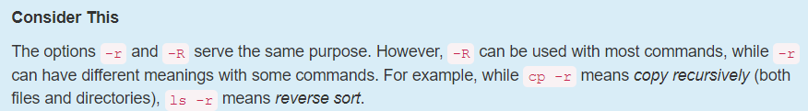
8.3.3 Copying Directories
Using the cp command to copy directories will result in an error message:
However, the -r (recursive) option to the cp command will have it copy both files and directories.
sysadmin@localhost:~$ cp -n /etc/skel/.* ~
cp: omitting directory `/etc/skel/.'
cp: omitting directory `/etc/skel/..'
Be careful with this option. The entire directory structure will be copied. This could result in copying a lot of files and directories!

Slide 17
8.4 Moving Files

Slide 18
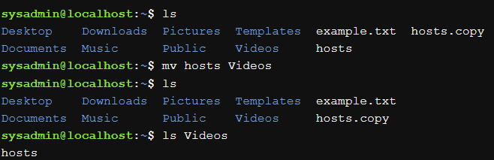
Moving Files - mv
To move a file, use the mv command.
The syntax for the mv command is much like the cp command:
When a file is moved, the file is removed from the original location and placed in a new location.
Note: If you don't have the right permissions, you will receive a "Permission denied" error message.
mv [source] [destination]

Slide 19
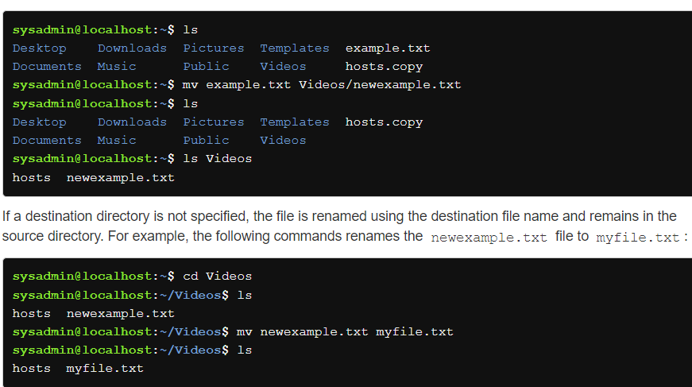
8.4.1 Moving Files - Renaming Files
The mv command is not just used to move a file, but also to rename a file.
The name of the file will change only if a destination file name is also specified.

Slide 20
Moving Files - Additional mv Options
Like the cp command, the mv command provides the following options:
Important: There is no -r option as the mv command will by default move directories.
Option | Meaning
-i | Interactive: Ask if a file is to be overwritten.
-n | No Clobber: Do not overwrite a destination files' contents.
-v | Verbose: Show the resulting move.

Slide 21
8.5 Creating Files and Directories

Slide 22
8.5 Creating Files
To create an empty file, use the touch command as demonstrated below:
Notice the size of the new file is 0 bytes. As previously mentioned, the touch command doesn’t place any data within the new file.
sysadmin@localhost:~$ ls
Desktop Documents Downloads Music Pictures Public Templates
Videos
sysadmin@localhost:~$ touch sample
sysadmin@localhost:~$ ls -l sample
-rw-rw-r-- 1 sysadmin sysadmin 0 Nov 9 16:48 sample
sysadmin@localhost:~$ ls
Desktop Downloads Pictures Templates sample
Documents Music Public Videos

Slide 23
Making Directories
To create a directory, use the mkdir command:
sysadmin@localhost:~$ ls
Desktop Documents Downloads Music Pictures Public Templates
sample.txt
sysadmin@localhost:~$ mkdir test
sysadmin@localhost:~$ ls
Desktop Downloads Pictures Templates test
Documents Music Public sample.txt

Slide 24
8.6 Removing Files and Directories

Slide 25
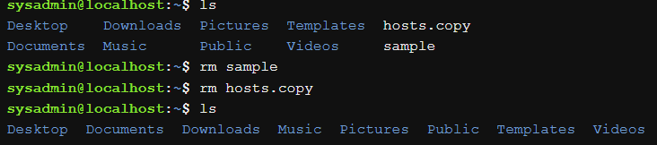

8.6 Deleting Files
To delete a file, use the rm command:
Using the rm could cause problems when deleting multiple files by using glob characters.
As a precaution, users should use the -i option when deleting multiple files.

Slide 26
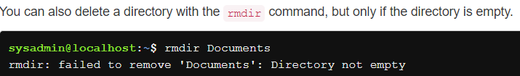
8.6.1 Deleting Directories
The rm command can be used to delete directories. However, the default usage (no options) of the rm command will fail to delete a directory:
To delete a directory, use the -r (recursive) option to the rm command:
Important: When a user deletes a directory, all of the files and subdirectories are deleted without any interactive question. It is best to use the -i option with the rm command.
sysadmin@localhost:~$ rm Videos
rm: cannot remove `Videos': Is a directory
sysadmin@localhost:~$
sysadmin@localhost:~$ rm -r Videos

